Slide 1


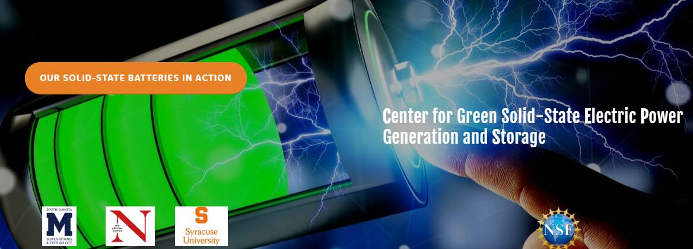

VISION, CAPABILITIES & UNIQUENESS
www.GreenCEPS.com

Slide 2

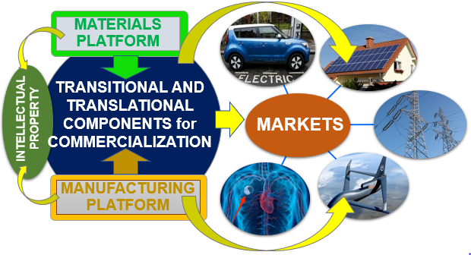
CEPS vision of the next-generation solid-state energy storage technology
Solid-state technology is critical
Many industry players are involved
Global interest to CEPS is growing fast
Major Market Segments
Portable
Transportation
Residential
Electric power grids
Aerospace
Military
Notes:
Full spectrum of applications

Slide 3
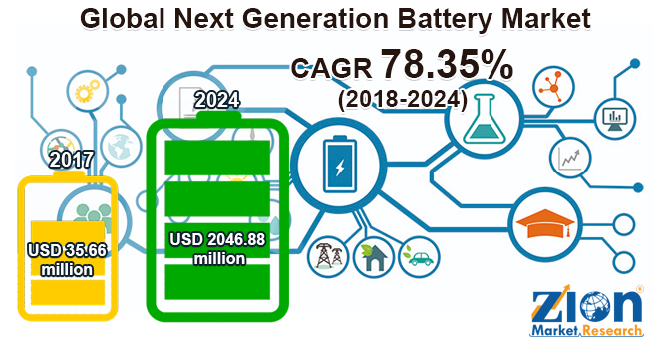
HUGE and FAST-GROWING Battery Market
Conventional batteries with liquid electrolytes reached the limit of their technological capabilities
New strategy is focused on solid-state battery technology

Slide 4
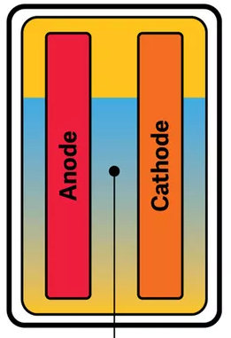
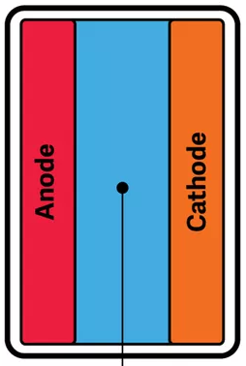
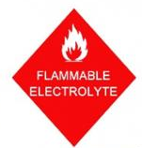
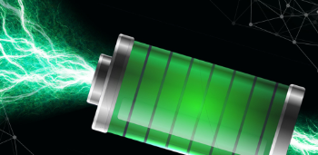
CONVENTIONAL BATTERY vs. Solid-State BATTERY
Fast charging
Long-range
Long lifetime
Inexpensive
Safe
Small and light
Highly efficient
Eco-friendly
Can use lithium as anode
Works for many applications
Liquid Electrolyte
Solid Electrolyte
Notes:
1. 2018 Department of Energy Announces $19 Million for Advanced Battery and Electrification
Research to Enable Extreme Fast Charging
2. 2019 ARPA-E’S 19 NEW PROJECTS FOCUS ON BATTERY MANAGEMENT AND STORAGE
3.
Solid-state energy storage technology is the key to the environmental sustainability.
Lithium metal : 3860 mAh g−1 and the lowest electrochemical potential of −3.04 V vs.
HP Laptops: 50,000 Li-ion Batteries recalled
Samsung Galaxy 7 i-phones: $10-17B loss
Boeing
LIB cathode is responsible for energy density (Du et al.)
https://batteryuniversity.com/learn/archive/the_high_power_lithium_ion
Energy Density (Wh/kg)- longer range is a measure of how much energy a battery can hold.
The higher the energy density, the longer runtime.
LIB anode is responsible for power density (Wh/liter) distance on single charge: MUCH LONGER

Slide 5
CHALLENGES of Solid-State BATTERY R&D
Choice of solid-state electrolyte (low lithium-ion transport, often high cost, processability)
Choice of cathode (complex architecture)
Three major cathode components should be balanced
Ionic conductor (solid-state electrolyte)
Electronic conductor (e.g. graphite)
Insulator (active cathode material for lithium ion storage)
Processes at the interfaces can be optimized only through a combination of modelling and in-situ/operando
Manufacturing challenges (conditions, thickness, etc.)
Solid Electrolyte
Notes:
1. 2018 Department of Energy Announces $19 Million for Advanced Battery and Electrification
Research to Enable Extreme Fast Charging
2. 2019 ARPA-E’S 19 NEW PROJECTS FOCUS ON BATTERY MANAGEMENT AND STORAGE
3.
Solid-state energy storage technology is the key to the environmental sustainability.
Lithium metal : 3860 mAh g−1 and the lowest electrochemical potential of −3.04 V vs.
HP Laptops: 50,000 Li-ion Batteries recalled
Samsung Galaxy 7 i-phones: $10-17B loss
Boeing
LIB cathode is responsible for energy density (Du et al.)
https://batteryuniversity.com/learn/archive/the_high_power_lithium_ion
Energy Density (Wh/kg)- longer range is a measure of how much energy a battery can hold.
The higher the energy density, the longer runtime.
LIB anode is responsible for power density (Wh/liter) distance on single charge: MUCH LONGER

Slide 6
CEPS concept and strategy towards the GREAT CHALLENGE of SOLID-STATE energy storage
Two interdigitated platforms: Materials (green) and Materials Manufacturing (yellow)
Synergistically combined with prediction modelling and in-situ operando
Notes:
Full spectrum of applications

Slide 7

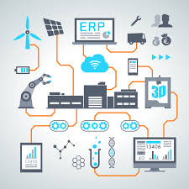



The NSF IUCRC CEPS MODEL
THREE UNIVERSITIES
(CURRENT STATUS)
CEPS MEMBERS
INDUSTRY, NATIONAL LABS, & the GOVERNMENT
SDSMT
Notes:
https://www.nsf.gov/eng/iip/iucrc/home.jsp
Potentially large network of universities & CEPS members
The center will grow with time
NSF requires universities to charge lower overhead

Slide 8

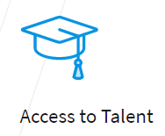
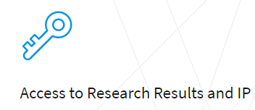
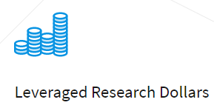
What distinguishes US from other CENTERS?
Exclusive focus on solid-state battery technology
Applicable to all areas of energy storage
Unmatched value to Industry
High ROI
8
Notes:
1. Opportunity to mentor and train students to attain desired skills for work in your industry
Access to Research Results and IP
2. Gain royalty-free, non-exclusive licenses on intellectual property produced in the center
Leveraged Research Dollars
3. Earn high return on investment when research is jointly funded

Slide 9
CEPS Benefits
https://iucrc.nsf.gov/
Help small business companies to grow
Only 10% F&A on your specific project
Opportunity to acquire additional funding under IUCRC umbrella authorized by NSF, such as https://iucrc.nsf.gov/universities/solicitation and Interagency Transfer Agreements https://iucrc.nsf.gov/universities/solicitation/iucrc-interagency-agreement-requests
Non-exclusive (free) or exclusive IP from all CEPS projects
Pre-competitive research with other companies: https://www.greenceps.com/industry
Facilitate existing companies to expand their IP portfolio and production lines
Develop federally sponsored national research centers
Develop energy storage workforce
Create new technologies for improved competitiveness in energy storage
Notes:
Full spectrum of applications

Slide 10
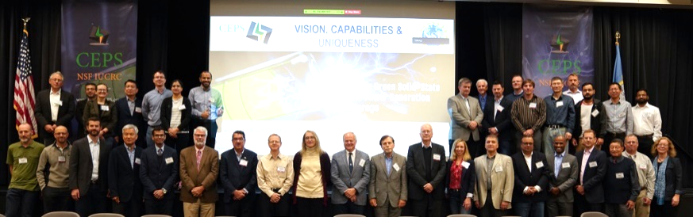
OUR Ask
Deadline for submission of Phase I NSF IUCRC CEPS proposal is September 8th, 2020
We are looking for your participation in CEPS
We need your signature on a non-binding letter of support (includes the language required by NSF)
Participants of the NSF IUCR CEPS Planning grant meeting at SDSMT campus, Rapid City, SD (September 12-13, 2019). https://www.greenceps.com/ceps-planning-grant-meeting

